Slide 1
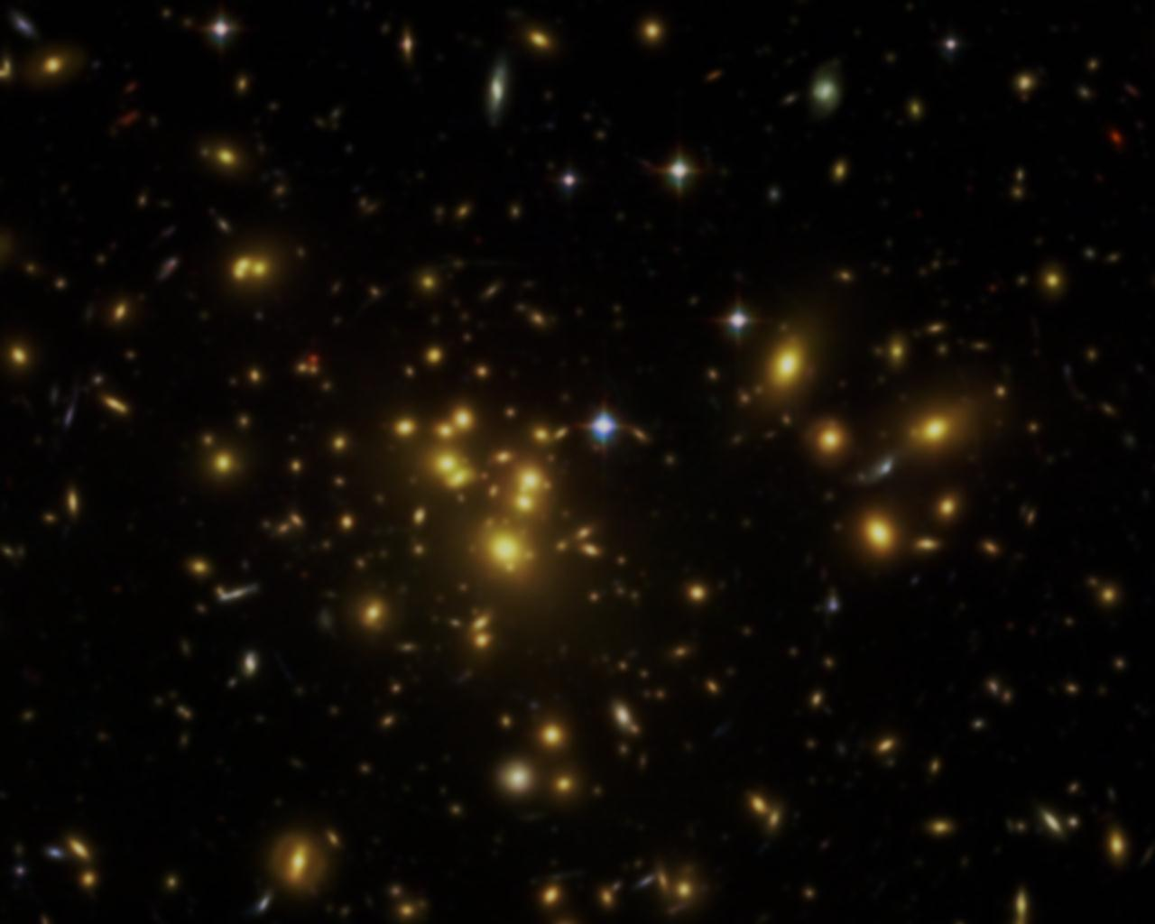
Studying the Dynamical Disturbance in Galaxy Clusters Cores through Analysis of Chandra X-ray Observations
Biswas Sharma
Morehead State University, KY
Supervisor PhD Student: Alberto Doria
Argelander-Institut für Astronomie
Rheinische Friedrich-Wilhelms-Universität Bonn
Notes:
http://space.mit.edu/home/kanderss/clusters2010/abell1689.jpg

Slide 2
Outline
Introduction and Motivation
Data Reduction
Data Analysis
Results and Future Work

Slide 3
Introduction
X-ray emission from hot intracluster gas
Brightest Cluster Galaxy (BCG)
X-ray peak/BCG offset => Relaxed/unrelaxed (Katayama et al. 2003, Sanderson et al. 2009, Hudson et al. 2010, Mann & Ebeling 2012)
Notes:
Cluster: ZwCl 0024+1652

Slide 4
Introduction
X-ray peak: found by analysis of Chandra X-ray observations
BCG location: found by analysis of optical observations
Dynamical disturbance measurement: in relaxed clusters, BCG’s location coincides with the X-ray peak

Slide 5
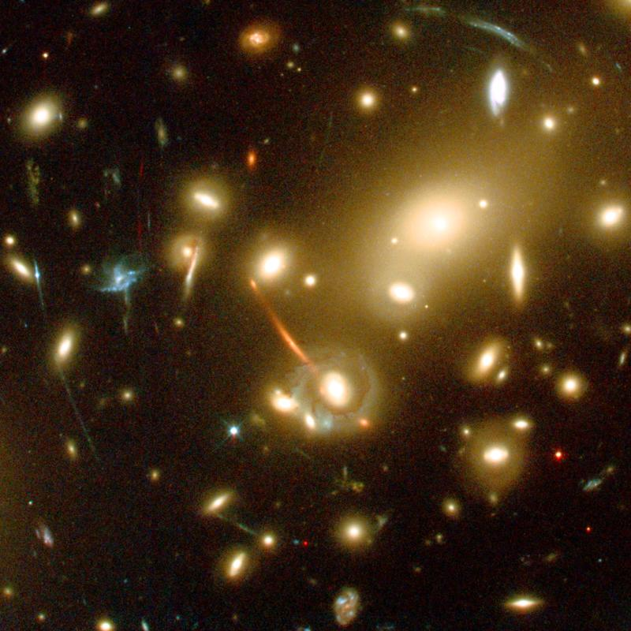
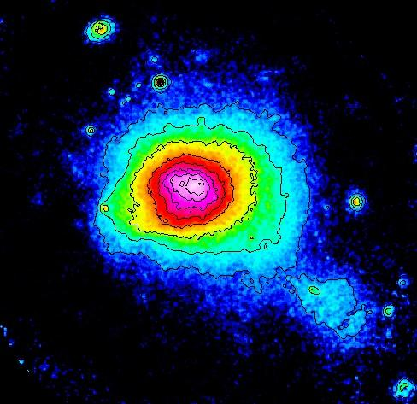
Motivation
Mass approximation:
Gravitational lensing
X-ray luminosity
Hydrostatic Equilibrium
Hydrostatic equilibrium assumed in unrelaxed clusters
cannot be
Notes:
http://www.sudan.umn.edu/cdms/index2.shtml

Slide 6
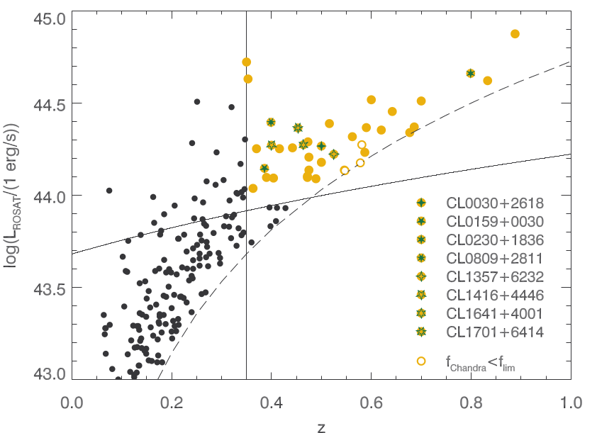
Data Reduction
Sampling
400d
Cosmological Sample
Burenin et al. 2007
Vikhlinin et al. 2009
Credit: Holger Israel
Flux limited sample
36 clusters (0.35 < z < 0.89)
Notes:
L_{x} > 10⁴⁴ ergs/s

Slide 7
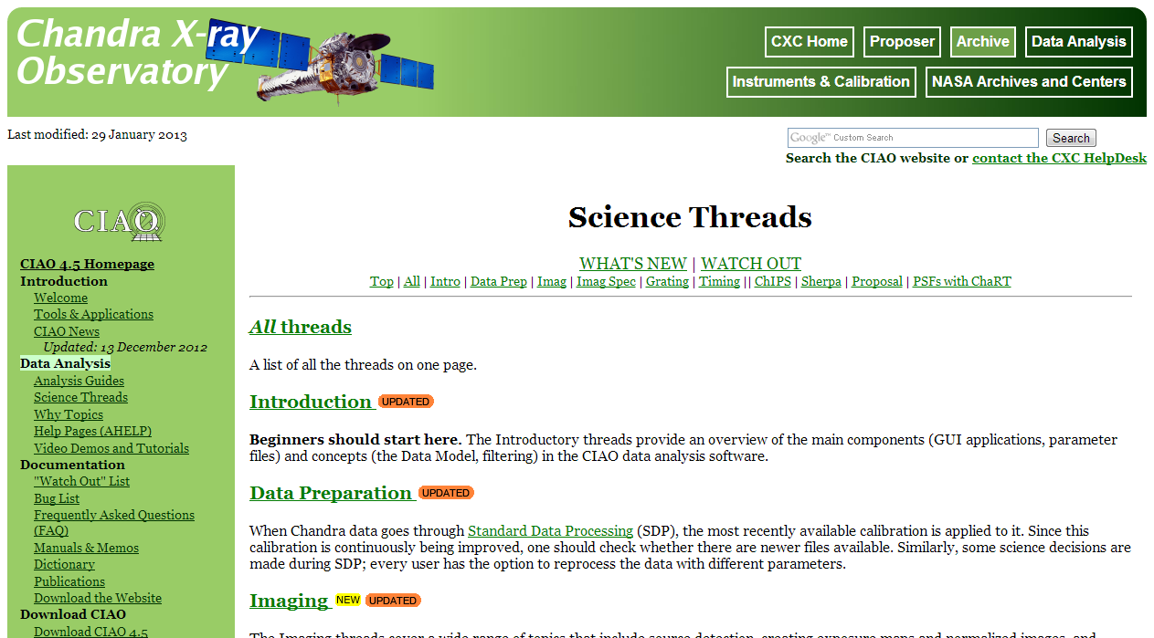
Data Reduction
Chandra X-ray Center

Slide 8
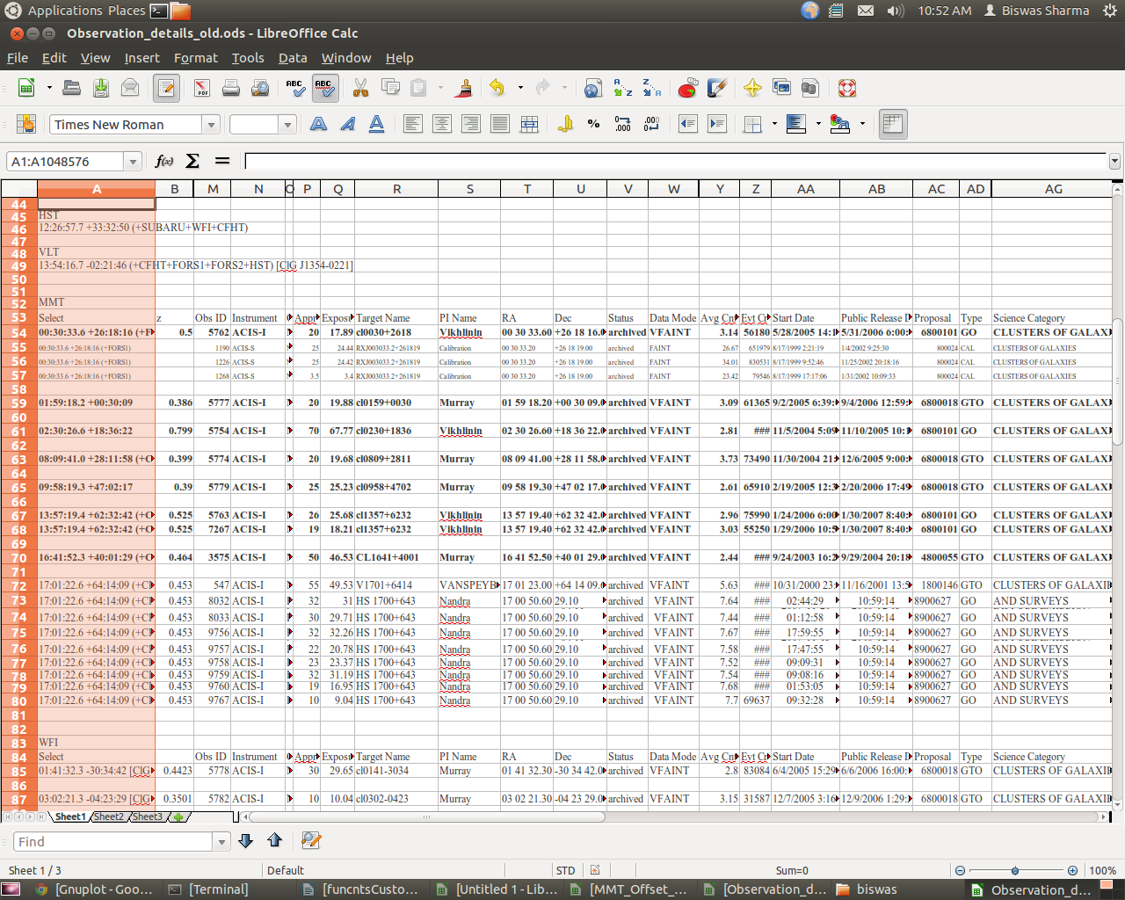
Data Reduction
Download

Slide 9
Data Reduction
Chandra_repro

Slide 10
Data Reduction
Subtracted all but ACIS I chips

Slide 11
Data Reduction
Point sources and cluster region

Slide 12
Data Reduction
Bad box?

Slide 13
Data Reduction
Flare subtraction – create background

Slide 14
Data Reduction
Flare subtraction – background creation

Slide 15
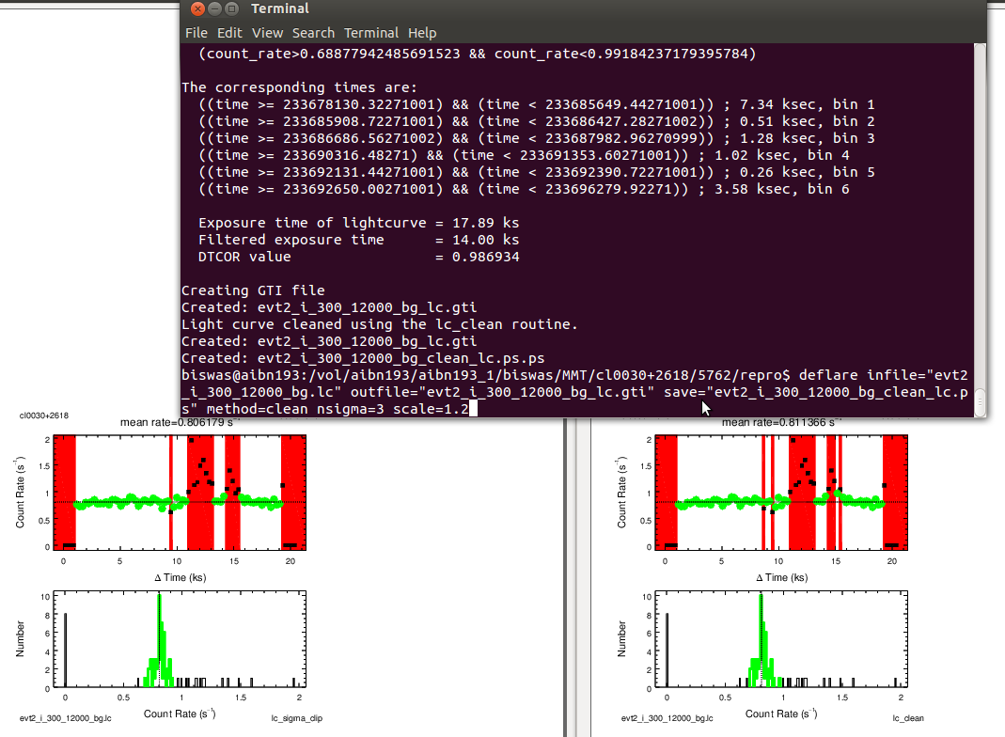
Data Reduction
Flare subtraction – lc_clean/lc_sigma

Slide 16
Data Reduction
Flare subtraction – clean file

Slide 17
Data Reduction
Xray peak > Background subtraction > average background surface brightness

Slide 18
Data Reduction
bkg_counts.reg

Slide 19
Data Reduction
Fluximage – soft, hard, broad, bin4, bin5, bin6, bin7

Slide 20
Data Reduction
aconvolve – Gaussian parameters (sigma) 2,3,4 tested

Slide 21
Data Reduction
dmimgcalc with values to subtract => background subtracted

Slide 22
Data Analysis
Manually checked which combinations of bin and Gaussian parameters gave good files, i.e., files without negative counts

Slide 23
Data Analysis
Fimgstat to get X-ray peaks

Slide 24
Data Analysis
BCG/WL centers from Alberto’s work

Slide 25
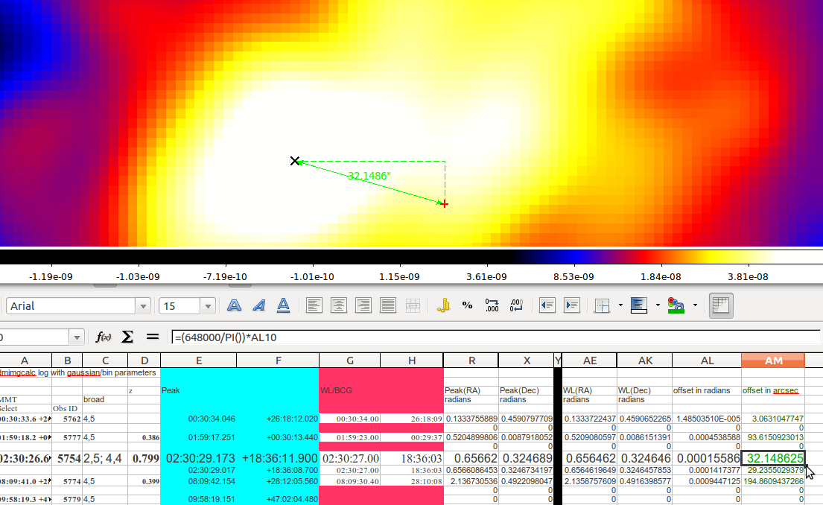
Data Analysis
Offsets checked with ds9 ruler and verified manually with formulas

Slide 26
Data Analysis

Slide 27
CL0030+2618

Slide 28
CL0159+0030

Slide 29
CL0230+1836

Slide 30
CL0809+2811

Slide 31
CL1357+6232

Slide 32
Cl 1641+4001

Slide 33
Cl 1701+6414

Slide 34
Cl 1416+4446

Slide 35
Future Work
All the clusters
Error bars on X-ray peaks
Emission weighted centers (use?)

Slide 36
Thank You
Questions?

Slide 37
Results

Slide 38
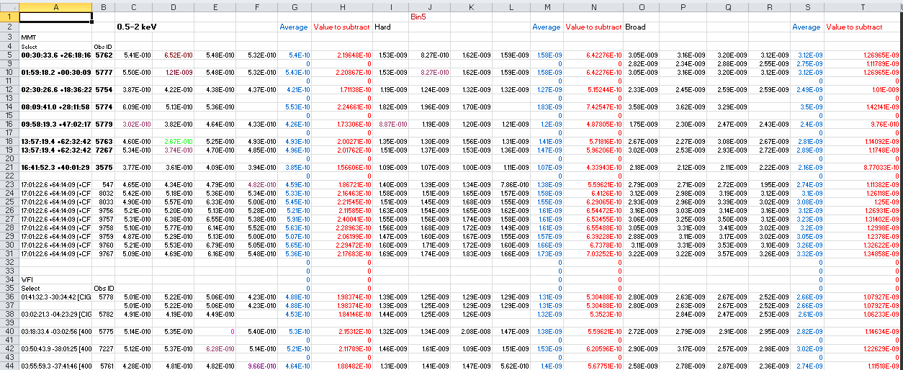
Data Reduction
funcnts on fluximages with bkg_counts.reg

Slide 39
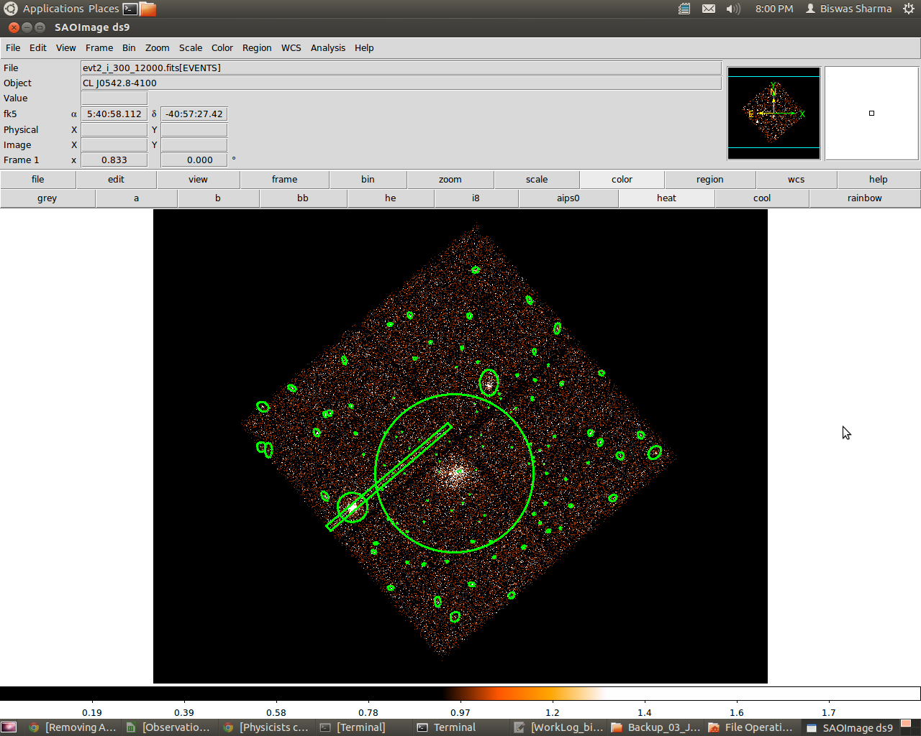
Notes:
Make regions more clear

Slide 40
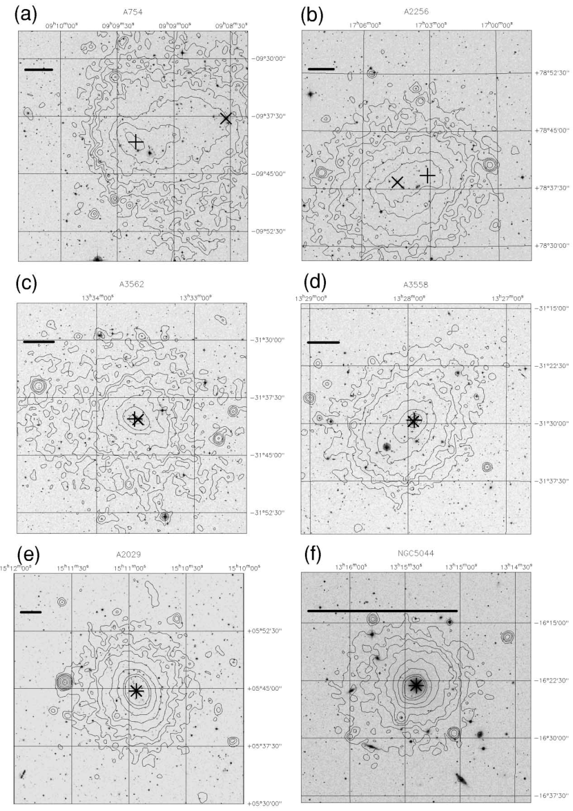
Preliminary Results and Future Work
Uncleaned observation file
Cleaned observation file
Offset analysis
_{Katayama et al. 2002}
Notes:
X-ray peak: through statistics of counts from the center….
Compare with BCG positions just to see if our clusters are in merging phase or in relaxed phase….
2r500 very close to virial radius of the cluster…
Put former and recent images to show difference…

Slide 41
